Slide 1
3D Pop Out Pictures
Pics that POP!

Slide 2
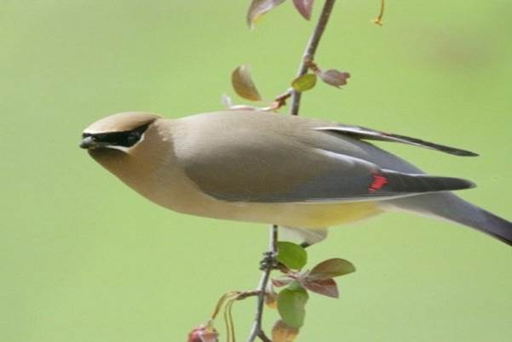
Notes:
Source Image with good contrast

Slide 3
Notes:
Copy / Paste source image

Slide 4
Notes:
Picture Tools…Format…Beveled Matte White border effect on source image

Slide 5
Notes:
Crop original to Trapezoid Shape

Slide 6
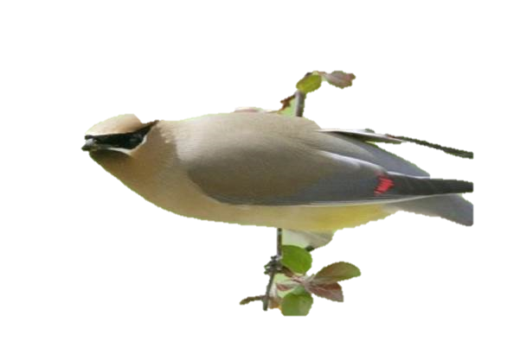
Notes:
Remove Background on copy – Keep Changes

Slide 7
Notes:
Move copy over Original – Line it up to match!

Slide 8
Notes:
Select both images and right-click…Group

Slide 9
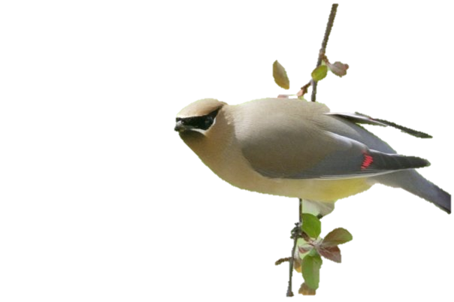
Notes:
Rotate…play with stuff!

Slide 10
For MORE tips & tricks:
LearnCamtasia.com/ppt

